Slide 1

NLP Based Question & Answers
for
E-commerce
Group 1
Mentors: Karthick & Parth
04/05/2020
Amit shende
Johny jose
Priyadarshini
Saranya
Vivek karthick

Slide 2
Business Objective:
An e-commerce company wants to build an algorithm to retrieve top 5 Question and answers based on the user given Keyword.

Slide 3
Project Architecture / Project Flow
Data source
Preprocessing
Feature Engineering
Stopword removal
Lowercasing
Tokenization
Lemmatization
In question and answer columns
Bag of words containing keywords for
TF-IDF
model
Cosine similarity
For
TF-IDF
model
Json file to dataframe
Deploying the model
Using flask
Building Recommendation of question and answer for the user input based on the similarity scores
Deployment
Model building
& prediction

Slide 4
Exploratory Data Analysis (EDA) and
Feature Engineering
Checking the available data, using functions such as describe, index, dtype.
Checking and handling Null values, unique values.
Counting the number of characters in question and answer columns by rows.
Part of speech Features for the question and answer column
Creating a word cloud for Answer and Question text.
Creating Most common Bigrams and Trigrams for positive phrases.
Finding the polarity in the Question and Answers
Visualizing the polarity sentiments.

Slide 5
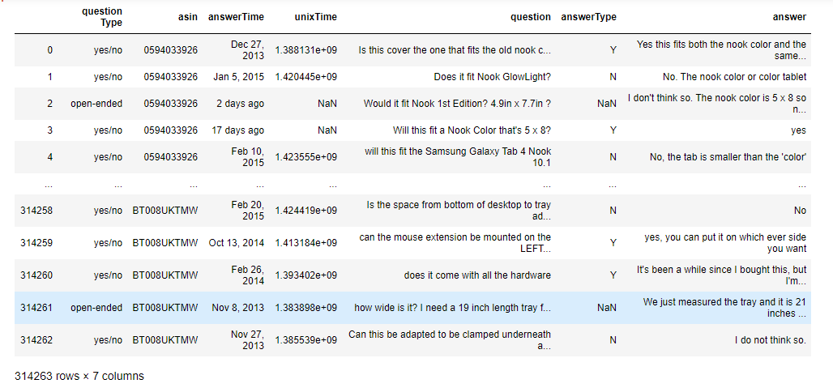
Data set details
How many rows, columns and unique values
Date ranges
Missing values
Etc..

Slide 6
Exploratory Data Analysis (EDA)
Example
71.87% of all the loans are two wheeler
TN, Gujarat, AP one (Telengana), Karnataka, Maharashtra contribute to 87% of total defaults; Central, Orissa, UP, each have less than 7% defaults
List out all your queries:
CustNetOutflow & CustDisbursementAmt has ‘0’ & negative values ?? Can it be?
CustFinanInterest 7800 entries out of 35k entries have interest rate < 1%

Slide 7

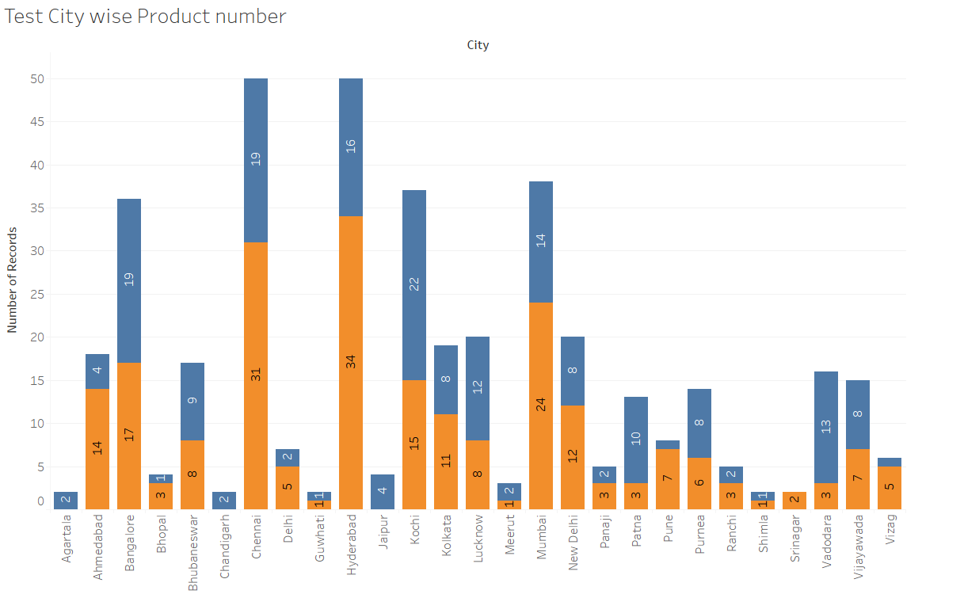
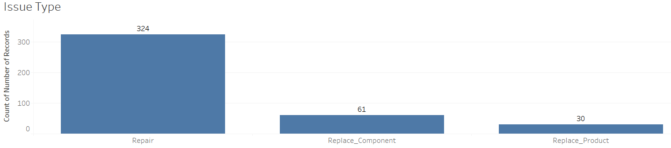
EDA
Look for problems in the data such as class imbalance, missing values, impossible values, and patterns ,similarities, distributions etcs..
Treat all the problems with appropriate techniques

Slide 8
Feature Engineering

Slide 9
Model Building

Slide 10
Template for Model results presentation
Model - SVM
Algorithms
Data set details
Algorithm details and configuration
Data Partition details
Accuracy:
Class wise accuracies
Recall
Precision
F1 score
Etc..

Slide 11
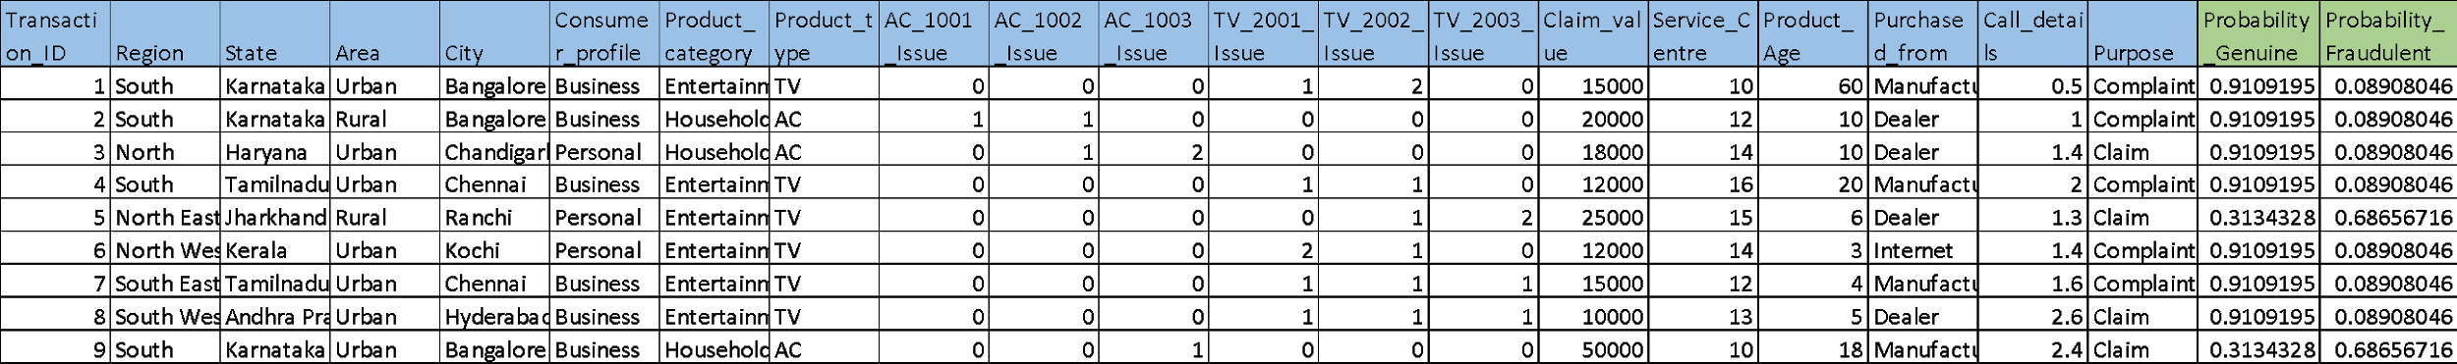
Model Predictions
Predicted probabilities for each transaction
Example
Transaction data fed to the model

Slide 12
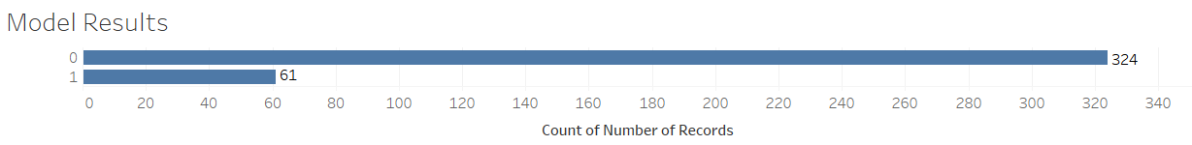
Model Results
Example
Model generated the output for the transaction data set in which 324 transactions are genuine(0) claims and 61 transaction are fraudulent(1)

Slide 13
Model Deployment using R shiny / Flask or any other method

Slide 14
Challenges faced?
How did you overcome?

Slide 15
Thank you

